Slide 1
Mini-Project V
Craig Lynch
August 19, 2021

Slide 2

Overview
Create a language translator
Convert a sentence in one chosen language to its counterpart in another chosen language, using Deep Learning and Natural Language Processing

Slide 3
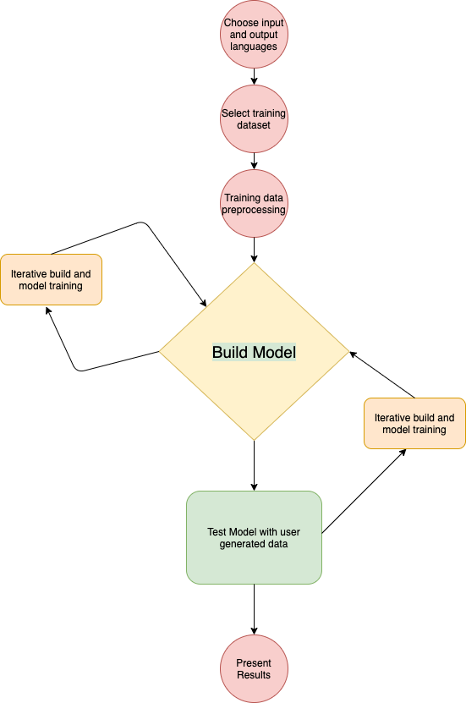
Project Flowchart

Slide 4
Data Pre-Processing

Slide 5
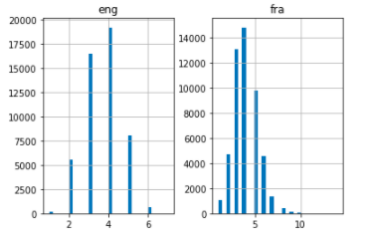
Understanding the data
Data Pre-Processing
Data was converted to Pandas for pre-processing
Punctuation removed
Convert all text to lowercase
Text to sequence conversion for sequence to sequence model
Vectorize data using Kera’s Tokenizer()
Pad sequences
Sentence Length
Notes:
My initial assumption was to drop the loan amount as I felt they should be processed after a loan was approved. However, after speaking with a mentor it was decided to keep them in

Slide 6
Model Building

Slide 7
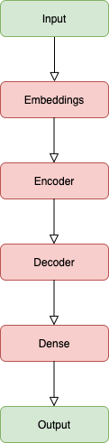
Sequence to Sequence Model Architecture
Input
Input Language: French
Embedding Layer
LSTM Layer
Encoder
LSTM Layer
Decoder
Dense Layer
Output
Output Language: English

Slide 8
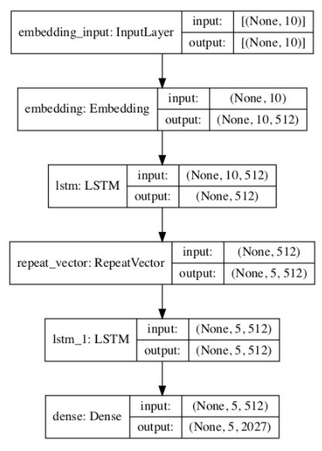
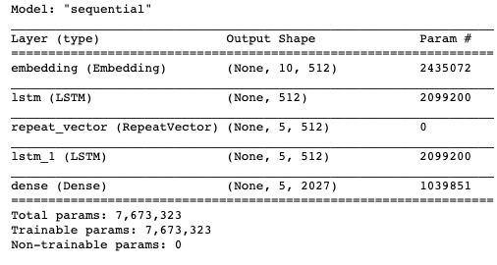
Graph Encoder - Decoder Model For Training

Slide 9
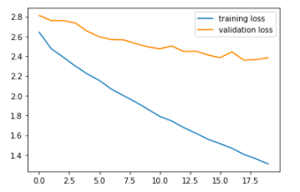
Training Loss vs. Validation Loss
Model Training
10,000 datas were trained for the final iteration
Trained over 20 epochs with a batch_size of 512
Validation split of 20%

Slide 10




Model Evaluation
Training Results
Testing Results
Notes:
My initial assumption was to drop the loan amount as I felt they should be processed after a loan was approved. However, after speaking with a mentor it was decided to keep them in

Slide 11
Moving Forward

Slide 12

Challenges and Moving Forward
Challenges
Computer power
Model training took over an hour
Sentence length
Comtrans dataset had a max sentence length of 39, which resulted in poor model performance
Performance increased with using a dataset with smaller sentence lengths
Moving Forward
Continue to train model
Optimize model architecture
Notes:
My initial assumption was to drop the loan amount as I felt they should be processed after a loan was approved. However, after speaking with a mentor it was decided to keep them in

Slide 13


Slide 14
Thank You

